Slide 1
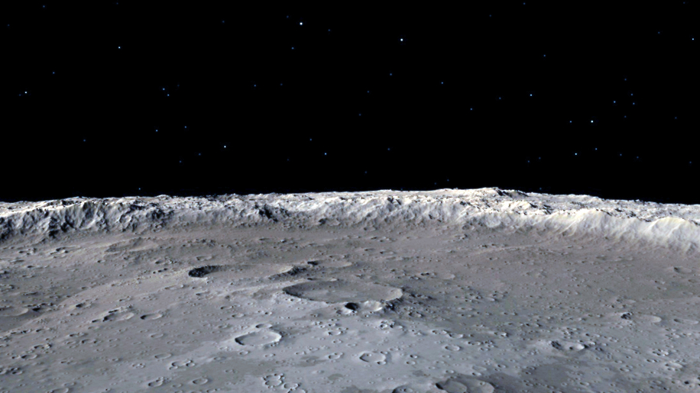

HSML Schema Updates
Databases & Verification
Alicia Sanjurjo Barrio (349B – Affiliate)
02/13/2025

Slide 2

Verification: Entity Registration system
User is prompted to upload their HSML JSON file of the new Entity they want to register.
Develop a Python API that:
Validates the JSON file (format, mandatory fields, and type check).
Checks for existing swid and warns the user if it will be overwritten.
Generates the did:key key pair using the CLI tool.
Attaches the did:key to the swid property in the JSON.
Stores the public key and updated JSON in the MySQL database.
Provides the private key (private_key.pem) and updated JSON to the user.
Notes:
The unique identifier is generated through a cryptographic process, this makes it impossible to guess the underlying key or DID

Slide 3
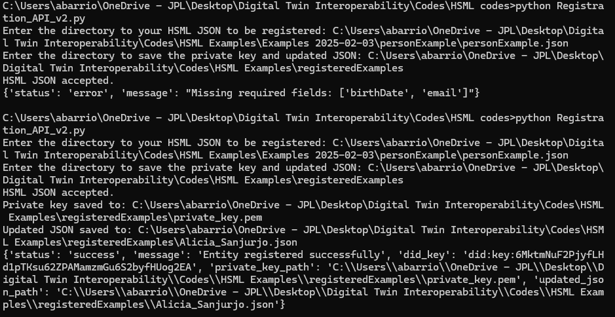
Registration API Initial Development
Example of registering my User identity using a Person HSML JSON using Python API:
There are certain mandatory fields to fill according to the Entity class
Notes:
The unique identifier is generated through a cryptographic process, this makes it impossible to guess the underlying key or DID

Slide 4
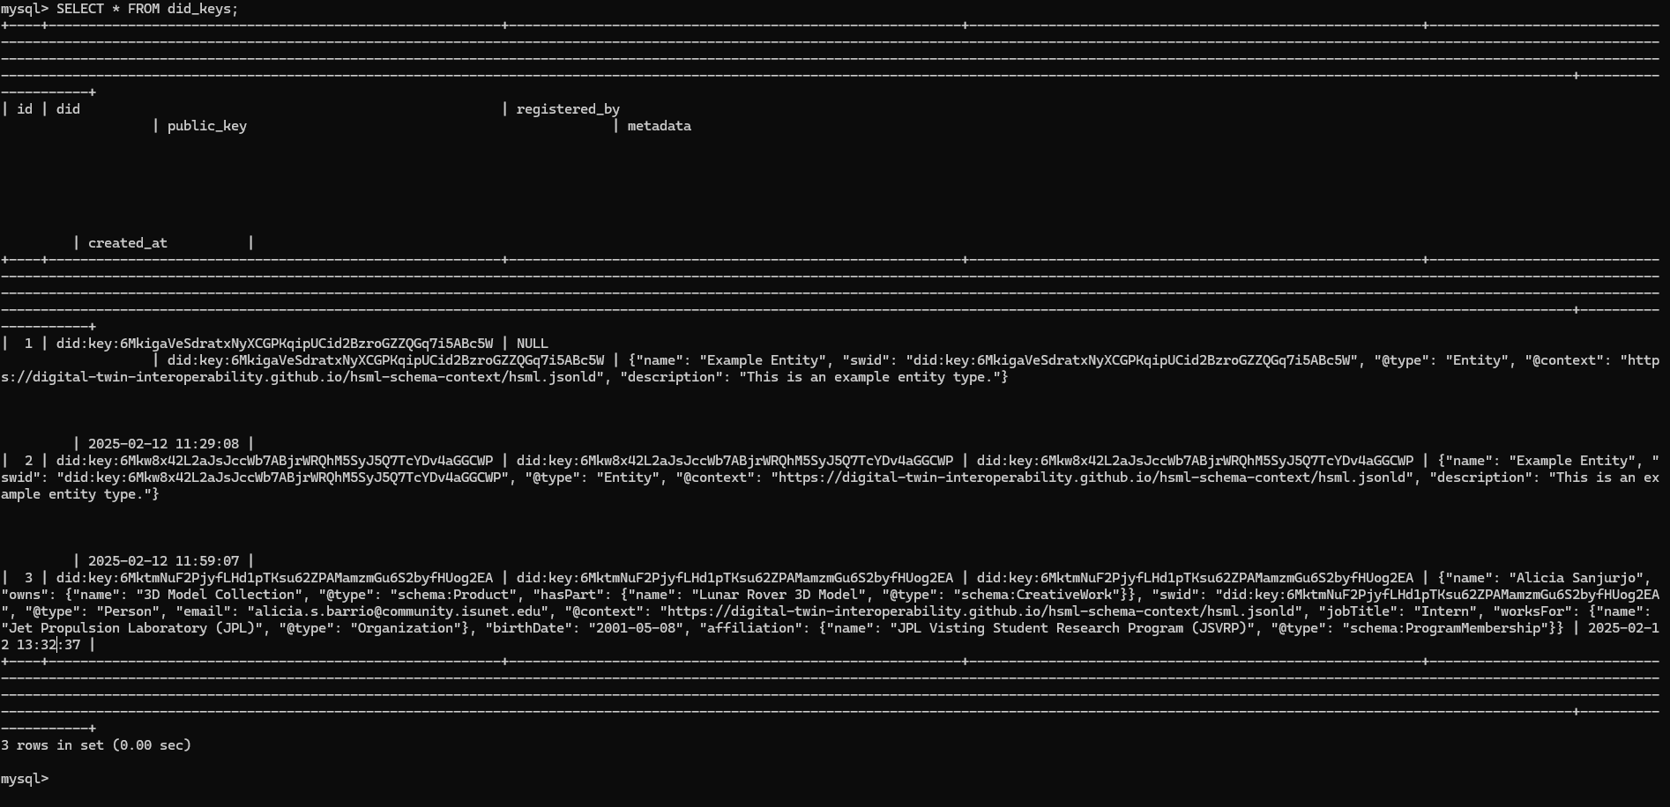
Registration API Initial Development
DID:key public key and HSML JSON with the metadata gets registered in MySQL database
Notes:
The unique identifier is generated through a cryptographic process, this makes it impossible to guess the underlying key or DID

Slide 5
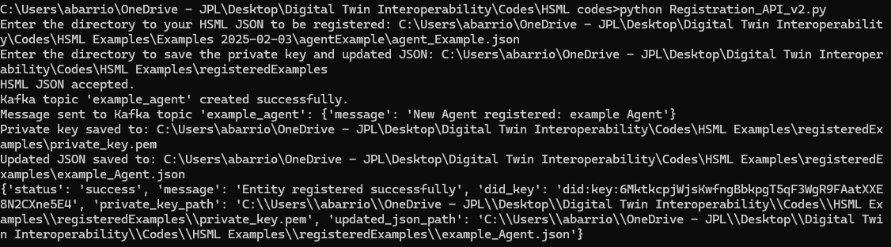
Registration API Initial Development
Example of registering and Agent HSML JSON using Python API:
Notes:
The unique identifier is generated through a cryptographic process, this makes it impossible to guess the underlying key or DID

Slide 6
MySQL Database – Registry Database
MySQL is an open-source relational database management system (RDBM) that stores data on disk by default (note: it is not an in-memory database).
Purpose: We want to use it as a permanent registry of the HSML Entities, in which we store the SWID (the DID public key) and the Entities metadata in HSML JSON files. This database would be used as a verification mechanism as it would contain all the HSML Entities identities and their connections to others. This way we can identify the users (Person type) and the Organizations they belong to, the Agents and their owners (Domain Authorities), the Hyperspaces they occupy, which Agents have Credentials associated to them and who has therefore access, the Contracts associated to Activities…
Why MySQL is the best option for Verification:
Ideal for long-term, structured storage
Supports JSON (files) columns & for multiple users to access/manage data simultaneously
Supports complex SQL queries for metadata filtering & verification
Notes:
The unique identifier is generated through a cryptographic process, this makes it impossible to guess the underlying key or DID

Slide 7
In-memory Database – Apache Ignite
Apache Ignite is a distributed multi-model IMDB that scales horizontally across memory & disk with full SQL support.
On the Verification side:
It could supplement MySQL by caching frequently accessed data for faster retrieval, i.e. for frequently accessed DID:keys
On the Models Storage side:
Apache Ignite also has a “Durable Memory” – need to enable “Native Persistence” option
It can apparently support USD and .obj formats
Q: What do we expect from this IMDB? Do we want users to upload their model to it right before they start streaming data and for others to be able to download them then? Or to have the models permanently stored and when the streaming starts these objects are moved from the disk to the ram?

Slide 8
Build Verification Part
Test 1 - DoD test in JPL Lab
JPL Server or EC2 if needed
Test 2 - HSML with 3 Platforms
Modify Producer/Consumers & JSON files
Test 3 - Verification Test with Platforms
Deploy SQL Database in JPL Network
Test 4 - Rovers Use Case
HSML API with In-memory Database
Define Business Logic for UC
Isaac Sim Modeling of UC Scenario
Physics Simulation 3 Platforms
Build simple AI agent
Rovers Communication Relay
Krono & Omniverse connection
AI Agent integration with BL
UC Integration with pub-sub and HSML
Path planning with LLM
BL and physics integration with HSML API
Implement Verification in Use Case
Refine Demo and Clean up Code
Demo Dry Run

Slide 9
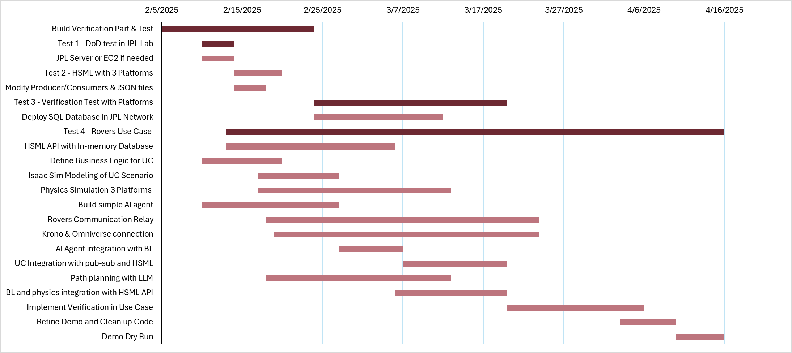

Slide 10
ADDITIONAL SLIDES

Slide 11
PREVIOUS TIMELINE

Slide 12
Tasks Needed – Priority List
Verification Part – Security & Trust in the Spatial Web:
Code to register in the SQL database a new Entity and its metadata, generate its DID:key, attach it to the JSON file, and give the user the private key for said Entity. Also, if the Entity is an Agent, during the registration an associated Kafka topic must be created.
Code to do the Cryptographic Verification when an user wants to Publish Data from an Agent (Producer) or wants to access the data of an Agent.
Test Verification works with a basic set-up of 2 Persons, 1 Agent, and 1 Credential. Record time needed for these operations, storage…

Slide 13
Tasks Needed – Priority List
2. Interoperability Part – Platforms, Compatibility, HSML Schema:
Test #1: Same test as DoD visit to check everything is working in JPL lab.
Test #2: Modify the JSON files to the latest HSML Schema format and test again communication among them.
Test #3: Incorporate Verification into the Test. Create a Credential and a Person (creator/user) for each Agent. Before sending the messages, verify identities of Producers and Consumers of the Kafka topic. (Min. test I need for my thesis)
Create a simple Interpreter (i.e. like Netscape Navigator)
Integrate GIBS data with HSML schema. Issue: this is Earth-related data, and our experiment is on the Moon’s surface. It would be a separate test.
Integrate TENA object models with our HSML schema.
Simulate collision. Get different platform colliders to talk to each other
Test #4: Exchange non-positional data between the Agents.

Slide 14
Tasks Needed – Priority List
3. Automation Part – Using LLMs:
Fine tune the LLM to create the conversion codes needed for each platform
Fine tune the LLM to generate correctly HSML json files from all kinds of data formats, by giving it HSML examples and the HSML schema.
Memory management by LLMs
Possible LLM Test 1: For a new platform (maybe Siemens) used FT LLM to generate conversion codes. Record time needed to generate them.
Possible LLM Test 2: Automatic generation of HSML json files from other types of files, given data of a person in a table, USD files, fbx… and so on, generate the json files. Track accuracy, success rate, time needed

Slide 15
Summary of Updates
NEW DOMAIN: The hsml.jsonld context file is hosted now using GitHub Pages in our lab’s repository. The new and definite link for the JSON files is: https://digital-twin-interoperability.github.io/hsml-schema-context/hsml.jsonld
Created did_registry SQL database in MySQL
Working on the Authentication & Authorization Architecture: Code to register in the SQL database and Code to do the Cryptographic Verification
Notes:
Google Drive direct link is not directly usable by JSON-LD parsers, but Dropbox’s direct file link

Slide 16





Verification in the Spatial Web
Producer
Consumer
Agent 1
Rover
did:key:123
Agent 2
Lander
did:key:xyz
Check Registry of DIDs
Credential
Access Lander
did:key:456
In the Credential is where it is written that Agent 2 (did:key:123) has access to Agent 1 (did:key:xyz)
Notes:
The unique identifier is generated through a cryptographic process, this makes it impossible to guess the underlying key or DID

Slide 17
Verification Logic
An Entity is registered, a DID key pair is generated for it. These Entity’s public+private keys get stored in a database together with its important metadata (name, description, creator…)
If the Entity is an Agent, during the registration an associated Kafka topic is created. This topic is where the Agent (rover, lander) can act as a producer.
On the producer side, before Agent can start publishing, public key is read from JSON by producer code. Program asks for private key of Agent, which is checked against public key in the database (to protect against spoofing).
If private key is correct, message is sent through server’s topic.
On the consumer side, to have access to Agent’s topic. User is asked for their private key. In database, it is checked if associated User’s public key is part of a Credential that authorizes access to that Agent.
If User has Credential, they can start consuming the data.
Notes:
The unique identifier is generated through a cryptographic process, this makes it impossible to guess the underlying key or DID

Slide 18


First Test – Minimum Entities Needed
Register
Register
Register
Person 1
User A
did:key:1a1
Agent 1
Rover
did:key:123
Credential 1
Access Lander
did:key:456
Associated
Kafka topic generated
Register
Person 2
User B
did:key:2b2
2. Register Agent associated with a Person (creator) and generate automatically the topic for that Agent to publish data
3. Register a Credential authorizing access to User B to the Agent of User B
1. Register two Persons in the Database with DIDs
Notes:
The unique identifier is generated through a cryptographic process, this makes it impossible to guess the underlying key or DID

Slide 19
Next Actions
New Domain for hsml.jsonld – GitHub is probably the best option
GitHub for the Lab
Create Database for DIDs and Metadata
Start building and modifying the Producer and Consumer codes to incorporate the Verification process
Integrate TENA object models with our HSML schema

Slide 20
Domain for HSML Schema
CURRENT DOMAIN SOLUTION: The hsml.jsonld context file is hosted in a Dropbox Direct link https://www.dropbox.com/scl/fi/fxyex9ndqp05316jyfexn/hsml.jsonld?rlkey=tmsoqgidjcfe4f4oa736tisfr&st=otxp4cck&dl=1
ISSUE: When the hsml.jsonld context schema file is updated, the direct link changes and therefore so does the link of the context used by the JSON files
Other Possible Solutions to have accessible JSON-LD file:
GitHub pages or GitHub Raw Content can serve a static file with a consistent URL, and it can be updated anytime by pushing changes to the repository.
Publicly accessible (but read-only) unless we use a private repository with GitHub Enterprise (paid)
Private Server or Cloud Storage with a fixed URL, best if we need privacy.
Requires a domain or static hosting like AWS S3 or Google Cloud Storage
Notes:
The unique identifier is generated through a cryptographic process, this makes it impossible to guess the underlying key or DID

Slide 21
DID Method
Primary Choice:
did:key
Reason: It’s fast, lightweight, and doesn’t require hosting a website or interacting with a blockchain. No domain registration, no storage, and no costs.
How this would work with Kafka:
To create a DID – use app or a CLI tool (can build a CLI tool with python)
Tool generates a key pair (public + private key)
Creates DID from the public key (like did:key:xyz123)
Your private key stays secret, and the DID becomes your public identifier
Notes:
The unique identifier is generated through a cryptographic process, this makes it impossible to guess the underlying key or DID

Slide 22

DID:key Method Implementation
A) MANUAL PROCESS
Public Key: Appears in JSON file as
“swid”: “did:key121lafj…”
For each new Entity, user runs
CLItool.py
generates a key pair
Private Key: Stays secret
(stored by user)
python CLItool.py --export-private
Using DID for Authentication:
Producers sign objects with private key
Consumers verify their signature using the public key
Notes:
The unique identifier is generated through a cryptographic process, this makes it impossible to guess the underlying key or DID

Slide 23
DID:key Uniqueness
It is extremely unlikely for two objects to receive the same DID:key
1. Cryptographic Randomness in Key Generation
CLItool utilizes a secure random number generator (CSPRNG) to create the private key. The Ed25519 algorithm operates on a 256-bit key space, which means there are 22562^{256} (about 107710^{77}) possible keys, which means that the probability of collision is ~0 even if billions of keys generated.
2. Deterministic Public Key Derivation
The public key is derived deterministically using the Ed25519 algorithm (same private key will always result in the same public key).
3. Multicodec and Base58 Encoding
The public key is combined with a unique multicodec prefix (b'\xed\x01' for Ed25519) and encoded in Base58 (DID:key format is consistent).
Notes:
The unique identifier is generated through a cryptographic process, this makes it impossible to guess the underlying key or DID

Slide 24
Q: Storage or No Storage?
Minimalist Approach (No Storage): rely purely on cryptographic verification when objects are consumed
Enhanced Functionality with Storage: use database or ledger to map each DID:key to additional metadata (e.g. domain authority, creator, roles, permissions…)
a) Using a JSON file (ex: did_registry.json)
b) Using a Database (more scalable)
c) Using a Web API for DID registry (simple REST API – using FastAPI)
Notes:
The unique identifier is generated through a cryptographic process, this makes it impossible to guess the underlying key or DID

Slide 25
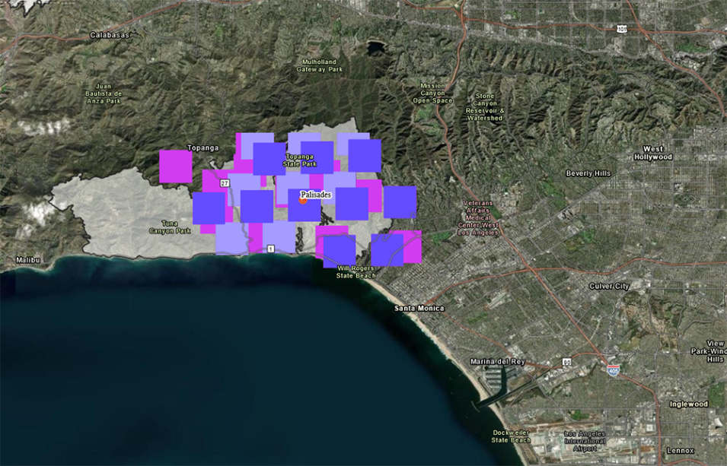
Objective
Show that Spatial Web based DT interoperability can support many types of services & access different types of data.
Global Imagery Browse Services (GIBS) APIs -
Global satellite imagery
Access using IEEE Spatial Web Protocol
DIGITAL TWIN
DATA
This image shows the first satellite-based fire detections in Pacific Palisades, CA, as they appeared on the FIRMS US/Canada map on Jan. 7, 2025. Credit: NASA FIRMS.
How to incorporate the WMTS Schema
How to support the RESTful protocol

Slide 26
OGC WMTS standard document
The OGC Web Map Tile Service (WMTS) standard defines a protocol for serving geospatial map tiles over the web. It provides a standardized way for clients to request and receive map tiles from a server, ensuring interoperability and scalability. The document includes specifications for both procedure-oriented (KVP and SOAP) and resource-oriented (RESTful) architectural styles.
Key Components of WMTS:
Tiling Scheme: A fixed grid system with specified bounds and resolutions for consistent tile generation.
Service Endpoints: Descriptions of how clients can request tiles using RESTful URIs, KVP (Key-Value Pair), or SOAP (Simple Object Access Protocol).
Metadata: The service provides metadata, often in XML (Capabilites document), describing the available layers, tile matrix sets, formats, and styles.
Standardized Formats: Tiles are typically served as PNG, JPEG, or other raster formats

Slide 27
HSML schema compatibility with WMTS schema
To fully achieve compatibility, we need to:
Map WMTS elements to the HSML schema.
Support both XML and JSON formats.
Implement and validate the required WMTS operations (GetCapabilities, GetTile, GetFeatureInfo).
Refer to the OGC WMTS schema for detailed specifications.
Python library "xmltodict"
Dictionary Structure
Python library “json"
XML
JSON
WMTS
HSML

Slide 28

RESTful Protocol
Principles of the Representational State Transfer (REST) architectural style: (AWS, 2024)
Uniform interface. Server transfers information in a standard format (HSML)
Statelessness. Server completes every client request independently of all previous requests.
Layered system. The client can connect to other authorized intermediaries between the client and server, and it will still receive responses from the server. Servers can also pass on requests to other servers.
Cacheability. Support caching.
Code on demand. Servers can temporarily extend or customize client functionality by transferring software programming code to the client.
Notes:
Support caching, which is the process of storing some responses on the client or on an intermediary to improve server response time.

Slide 29
Use Cases
Use Case 1. Lander of SpaceX and a JPL Rover
What do we need from each other?
What do we need to communicate? Position, attitude, images…
Lander – Camera, decide what to do. (Example: sees big rock, or very steep, find flat area)
JPL – uses DARTS
SpaceX – uses ???
Use Case 2. Satellite interacting with Ground Base
Endurance Rover to satellite – satellite location, signal strength, sun location, thermal condition, antenna pointing correctly
Use Case 3. Satellite Constellation, 2 satellites interacting with each other

Slide 30
Space Companies using Digital Twin Technology
SpaceX
Dragon Capsule Spacecraft
Siemens NX software on the design of entire rocket, to ensure that their rocket designs are fully functional by simulating motion.
To design and test their Starlink satellite internet constellation.
To optimize the design and testing of its Starship spacecraft.
Lockheed Martin
On NASA’s OSIRIS-REx Mission
NVIDIA to Build Digital Twin of Current Global Weather Conditions for NOAA
Sierra Space
Siemens Xcelerator platform and its DT technology to support its Dream Chaser

Slide 31
Use Cases
Data to be exchanged
Position/rotation
Speed
Sun location
Signal frequency
Signal strength
Sensor data
Status of instruments
Satellite Telemetry data (Satellite’s health, Status of instruments, payload data)
Can our protocol cover it?
Simulation tools used for DT
Unity
Unreal Engine
Omniverse
DARTS (JPL)
Siemens Nx, Teamcenter
…
How do we interface with those?

Slide 32
DID Method
Primary Choice:
did:key
Reason: It’s fast, lightweight, and doesn’t require hosting a website or interacting with a blockchain. No domain registration, no storage, and no costs.
How this would work with Kafka:
To create a DID – use app or a CLI tool (can build a CLI tool with python)
Tool generates a key pair (public + private key)
Creates DID from the public key (like did:key:xyz123)
Your private key stays secret, and the DID becomes your public identifier
Notes:
The unique identifier is generated through a cryptographic process, this makes it impossible to guess the underlying key or DID

Slide 33
Safety and Trustworthiness in the Spatial Web
“A verifiable and trusted identity is an essential necessity to enable the interactions, transactions, and transportation between people, places, or things.”
“Distributed Ledger Technologies enable a world where every identity, contract, transaction, and currency can be trusted and verified.”
“To register the identity of any user, space, or asset on the SW, an individual or organization must first create an account and request a globally unique “decentralized identifier” (DID) based on W3C Standards.”
René, G., & Mapes, D. (2019). The Spatial Web.

Slide 34
Safety and Trustworthiness in the Spatial Web
“Safety & Trustworthiness in the Spatial Web is enabled by Governance”
The main concepts for Governance are:
Credentials – used for authentication and identity – who can access a domain, and how can they interact with it
Norms – act as a principle of conduct or right action over domains
Contracts – binding agreement used to dictate activities and relationships among domains
4 aspects of trust between parties intermediated by digital technologies:
Authenticity – SWIDs (unique identifier)
Integrity
Confidentiality – HSTP
Privacy – Design principle

Slide 35
Credentials in Kafka
Verifying credentials, identities, and access rights requires a combination of cryptographic techniques, authentication protocols, and access control mechanisms.
Credential Verification, Domain Identity, and Access Control in Kafka:
Issue Decentralized Identifiers (DIDs) for producers, consumers, and brokers.
Use Verifiable Credentials (VCs) to grant roles like "producer" or "consumer" for specific topics.
Authenticate users using DID-Auth (challenge-response).
Check role-based access for producers/consumers.
Use encryption and signing for message confidentiality and integrity.

Slide 36
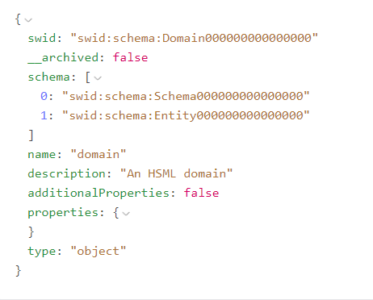
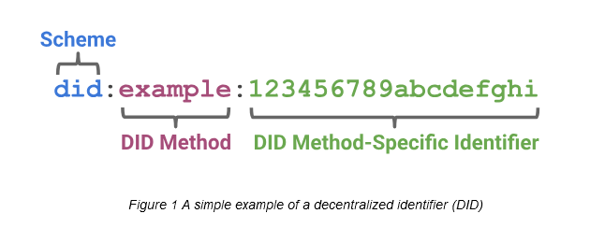
SWID and DID
The Identifier for the HSML schema, according to the Spatial Web standard, is the SWID. The Spatial Web Identifier (SWID) is a Decentralized Identity (DID) that conforms to W3C did-core, https://www.w3.org/TR/did-core/.
NO EXISTING SWID METHOD
USE AN EXISTING DID METHOD
Notes:
However,

Slide 37
DID Methods
The most used DID methods to generate the unique identifier are:
did:key
did:web
did:ethr
The unique identifier is generated through a cryptographic process, this makes it impossible to guess the underlying key or DID
Notes:
The unique identifier is generated through a cryptographic process, this makes it impossible to guess the underlying key or DID

Slide 38
DID Methods
Criteria | DID:ETHR | DID:WEB | DID:KEY
Privacy | Medium – Transactions are on a public Ethereum ledger, but can use zk-SNARKs for privacy. | Low – Relies on centralized control of DNS or domain hosting. | Low – No on-chain record, but depends on how keys are handled.
Easiness to Implement | Medium – Requires an Ethereum wallet and knowledge of smart contracts. | Easy – Requires ownership of a domain name and a simple JSON file hosted at a URL. | Easy – Purely key-based, no blockchain required.
Storage Needed | High – Stores state on Ethereum, costly for large datasets. | Medium – DID document is stored in a simple JSON file on the domain's web server. | Low – No storage required as it’s entirely key-based.
Notes:
The unique identifier is generated through a cryptographic process, this makes it impossible to guess the underlying key or DID

Slide 39

Spatial Web Ontology Entries
ENTITIES are the base items used across the Spatial Web in HSML
The Spatial Web ontology defines several classes. All classes are types of the Entity base class:
ACTIVITY
AGENT
CONTRACT
CHANNEL
CREDENTIAL
DOMAIN
HYPERSPACE/SPACE
TIME
HSML encodes ENTITIES in a format, e.g., JSON-LD

Slide 40
Agent has goals, senses, and responds, i.e. Lunar Rover
AGENT
Agent is a type of Domain. Agents can also sense other Domains
Activity is an action performed by an Agent
Agent can send messages through
the Channel
i.e. Lander, Rover, Moon surface
A Domain info can be sent through the Channel
CHANNEL
Channel contains messages related to an Activity
i.e. Leave the Lander
DOMAIN
ACTIVITY
A Domain can perform an Activity.
An Activity can be performed on a Domain
Domain references a Hyperspace
A Credential is made by a Domain (domain authority)
A Contract is done for an Activity
Activities take Time to be carried out
A Credential parties to a Contract
CREDENTIAL
CONTRACT
HYPERSPACE
TIME
Notes:
HYPERSPACE: A set of ‘points’ such that, for every ordered pair of points, there is a possibly empty set of ‘paths’ from the first point to the second, and such that there is an ‘identity’ path from every point to itself. Syn: SPACE.

Slide 41
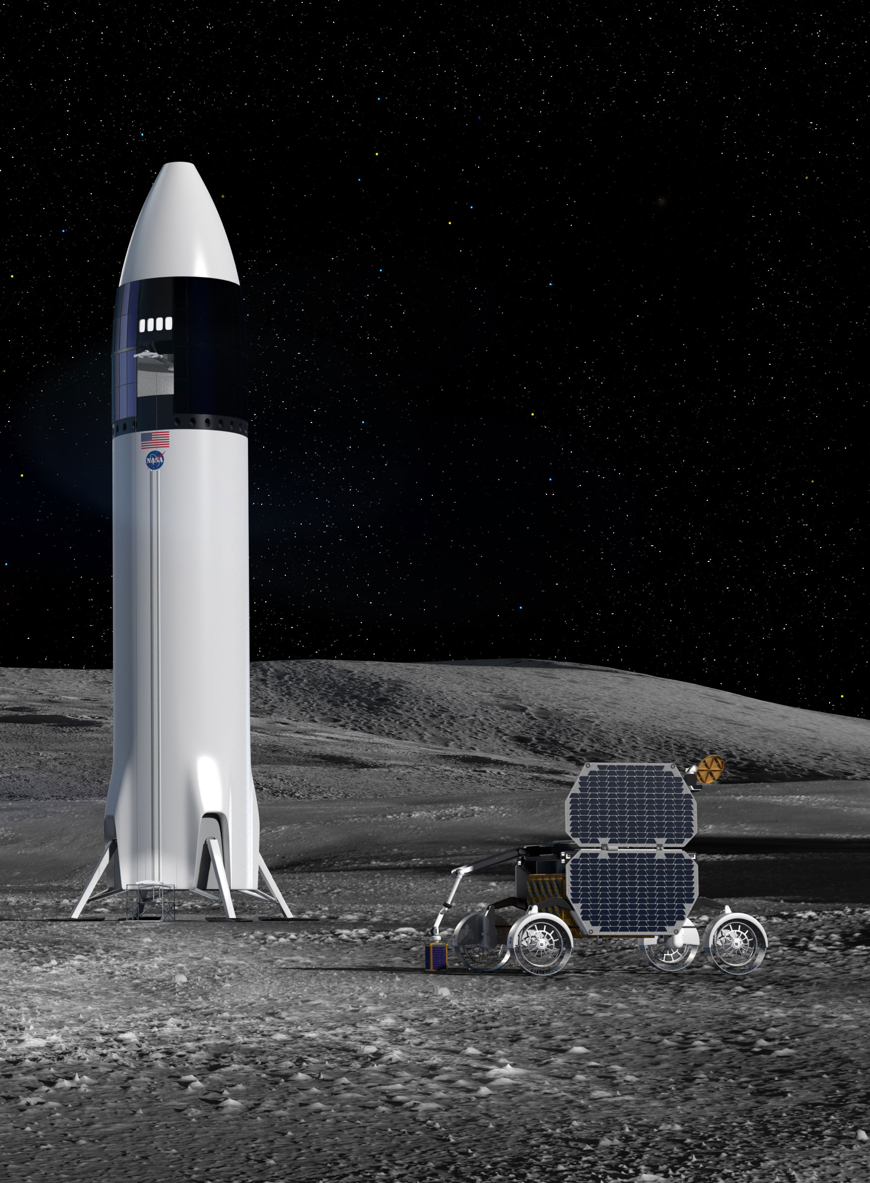
USE CASE:
Two Organizations, Company A and Company B, sign a Contract to work together on a space mission to the Moon.
The Rover of Comp. A will be carried inside the Lander of Comp. B. (Agents)
Once they reach the Moon, the Rover will leave the Lander. To make sure this Activity is developed without any problem, Comp. B needs to work with the model of the Lunar Rover and run some simulations.
A Credential is issued by Comp. A, authorizing Comp. B users (Person) to have access to the 3D Model of their rover for a Period of 3 Months (Time).
The model of the Lunar Rover is in Unreal, and the model of the Lander is in Omniverse; both have a Moon surface environment modelled. The Hyperspace must consider, the location (the Moon), and the appropriate coordinate systems and transforms needed to go from one platform to the other.
All the messages and communications related to this Activity are carried out in a Channel.

Slide 42
Organization: Company A
Channel: Communication between Comp A & B for Activity 1
Organization: Company B
Person: User 1
Person: User 2
Agent: Unreal Lunar Rover 3D Model
Agent: Omniverse Lunar Lander 3D Model
Activity 1: Leave the Lander
Credential: Ownership by Comp. A
Contract: Between Comp. A & B for Activity
Credential: Ownership by Comp. B
Credential: For Comp. B to use temporally Lunar Rover
Hyperspace: Moon, Coordinate System, Transform Unreal-Omniverse
USE CASE
Time: Period of 3 Months
Time: Activity Duration

Slide 43
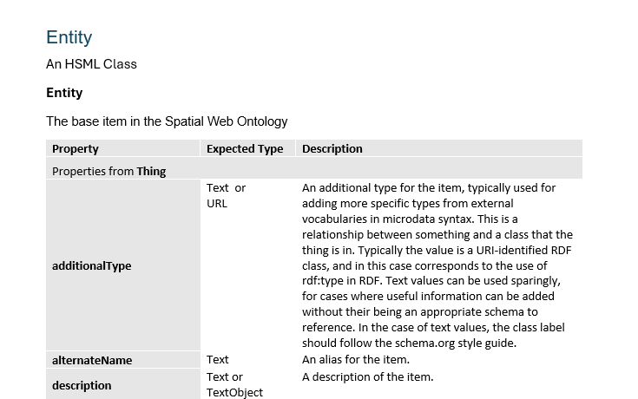
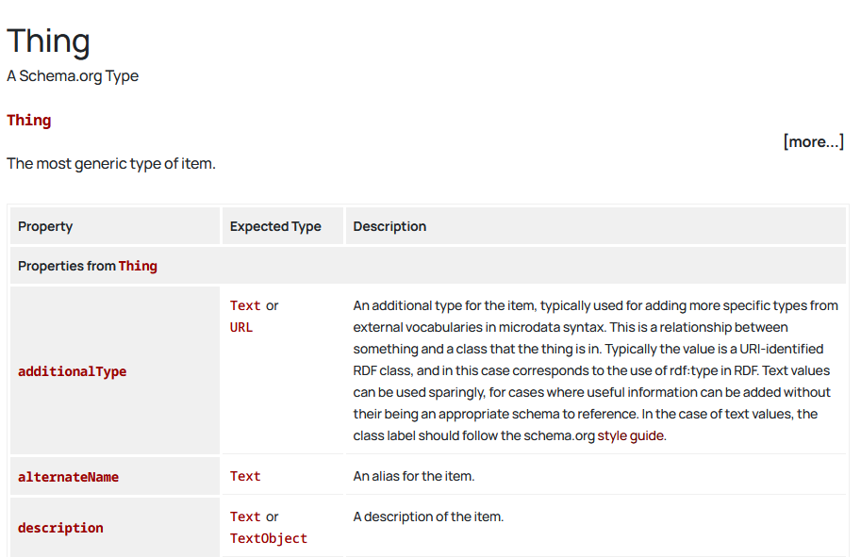
HSML Types Structure
Document currently under construction
Schema.org webpage

Slide 44
Spatial Web Safety and Security
“Safety & Trustworthiness in the Spatial Web is enabled by Governance”
Credentials, Norms & Contracts are the main concepts for Governance
Credentials – used for authentication and identity – who can access a domain, and how can they interact with it
Norms – act as a principle of conduct or right action over domains
Contracts – binding agreement used to dictate activities and relationships among domains
4 aspects of trust between parties intermediated by digital technologies:
Authenticity – SWIDs (unique identifier)
Integrity
Confidentiality – HSTP
Privacy – Design principle

Slide 45
Credentials in Kafka
Verifying credentials, identities, and access rights requires a combination of cryptographic techniques, authentication protocols, and access control mechanisms.
Credential Verification: Use VCs, DIDs, JWTs or ACLs.
Domain Identity: Use DIDs.
User Access Control: Check ACLs, DID VCs, or JWT tokens.
Domain Capabilities: Check DID Documents, VCs, or API responses
Credential Verification, Domain Identity, and Access Control in Kafka:
Issue Decentralized Identifiers (DIDs) for producers, consumers, and brokers.
Use Verifiable Credentials (VCs) to grant roles like "producer" or "consumer" for specific topics.
Authenticate users using DID-Auth (challenge-response).
Check role-based access for producers/consumers.
Use encryption and signing for message confidentiality and integrity.

Slide 46
SWID – DID (Decentralized Identifier)
The Spatial Web Identifier (SWID) is a Decentralized Identity (DID), so it does not rely on central authorities, it is a self-sovereign identity.
The unique identifier is generated through a cryptographic process, this makes it impossible to guess the underlying key or DID
How this would work with Kafka:
To create a DID – use app or a CLI tool (can build a CLI tool with python)
Tool generates a key pair (public + private key)
Creates DID from the public key (like did:key:xyz123)
Your private key stays secret, and the DID becomes your public identifier

